Slide 1
Fake News Detection
By,
Somesh Panchal
180410107052
Computer dept., SVIT

Slide 2
Introduction
The problem of unreal or fake news has been around since the creation of the free press. According to John Adams, the second president of the United States of America,”There has been more new error propagated by the press in the last ten years than in an hundred years before 1798.” As innovations such as the Internet and social media allowed people to easily connect, it also helped spread news that is misleading or untrue. This term was put into popularity in the 2016 election, when articles spreading over social media had no factual standing. One of the most prominent examples of this is when the article”Pope Francis shocks world, endorses Donald Trump for president,” spread over Facebook and had over 900 thousand views. While this article simply wasn’t true in any way, it still managed to influence the election. Fake news sites such as the Onion or propaganda made by the government are other examples of modern fake news.

Slide 3
Certain social media websites have come under fire because of fake news and how they aren’t reacting to the spread of it. Facebooks CEO Mark Zuckerberg has stated that his company plans on utilizing machine learning to help prevent the spread of fake news. However, he wasn’t specific on what his approach would be or how effective that approach is. For decades, machine learning has been used to help find spam emails or bots, but detecting fake news requires a much different approach. In this project, we developed a model for detecting fake news that utilizes both text feature extraction and binary classification algorithms. We will also present a database that contains thousands of examples of news articles classified as REAL or FAKE. Using this dataset, we will create a program that will extract linguistic features and then create a classifier that learns from these features to effectively predict the accuracy of news.

Slide 4
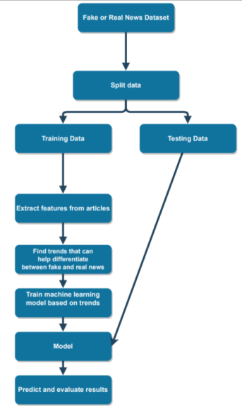
The whole process the classifier

Slide 5
Vectorization
CountVectorizer :
tokenizes(tokenization means breaking down a sentence or paragraph or any text into words) the text along with performing very basic preprocessing like removing the punctuation marks, converting all the words to lowercase, etc. The vocabulary of known words is formed which is also used for encoding unseen text later. An encoded vector is returned with a length of the entire vocabulary and an integer count for the number of times each word appeared in the document. The Bag of Words(BoW) model is a fundamental(and old) way of doing this. The BoW model is very simple as it discards all the information and order of the text and just considers the occurrences of the word; in short it converts a sentence or a paragraph into a bag of words with no meaning. It converts the documents to a fixed-length vector of numbers.

Slide 6
TF-IDF
TF-IDF is an algorithm that gives weight to how important a word is in a document. TF-IDF first calculates term frequency (number of times word appears in document vs. number of words in document). But because words such as”the” and”or” appear frequently in many documents, TF-IDF devalues words that show up in more documents. This leaves only the relevant words in our text analysis. All of the TF-IDF values will add up to 1.
While this feature may sound very simple, it is advantageous and it has a hand in Google searches. By using tfidf, researchers can determine what each article was about and what the keywords of the article are. Below is the formula for tfidf value. tfi,j stands for number of occurrences of i in j. N stands for the total number of documents in the data set. dfi stands for the number of documents containing.

Slide 7
tf-idfi,j = tfi,j ∗ log( N/dfi )
According to an experiment run by Juan Ramos of Rutgers University, TF-IDF was able to find terms more relevant to documents than a naive brute force approach or simply using a bag-of-words model.

Slide 8
Used Classifiers
Naïve Bayes: Naïve Bayes uses probabilistic approaches and are based on Bayes theorem. They deal with probability distribution of variables in the dataset and predicting t he response variable of value. They are mostly used for text classification.
Bayes theorem is P(a|b) =p(b|a)p(b)/p(a) There are mainly 3 types of naïve base model as - Gaussian Naïve Bayes, Multinomial naïve Bayes and Bernoulli Naïve Bayes. We have used Multinomial Naïve Bayes model for our project to detect fake news. An advantage of naïve Bayes classifier is that only requires less training data for classification.
Received Result: If classifier fined news article as fake, then: The true positive are the correctly classified as fake news articles. The false positive examples are the incorrectly classified as fake articles. The true negative are the correctly classified as real news articles. The false negative examples are incorrectly classified as real news articles.

Slide 9
Passive Aggressive Classifier (PAC)
PAC observes instances in a sequential manner and predicts an outcome (in our case it would be fake or real). Once the algorithm makes a prediction, it receives feedback on how it did. Then, if the mechanism was incorrect, it will modify itself to help make more accurate predictions. It will change the weight vector to match the incorrect prediction as well as the previous data points.

Slide 10
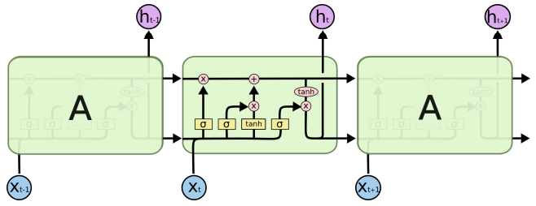
LSTM

Slide 11
Long Short Term Memory networks – usually just called “LSTMs” – are a special kind of RNN, capable of learning long-term dependencies.
They work tremendously well on a large variety of problems, and are now widely used. LSTMs are explicitly designed to avoid the long-term dependency problem. Remembering information for long periods of time is practically their default behavior, not something they struggle to learn!

Slide 12
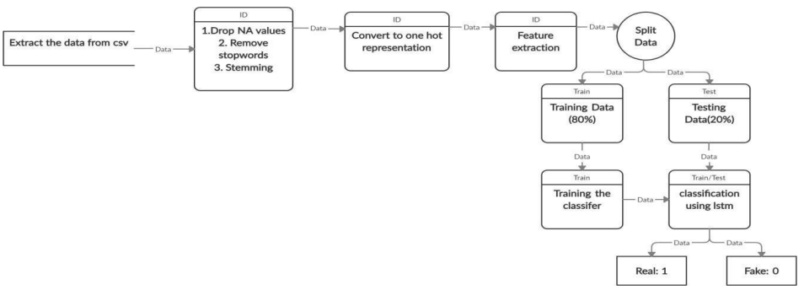
Process of LSTM classifier

Slide 13
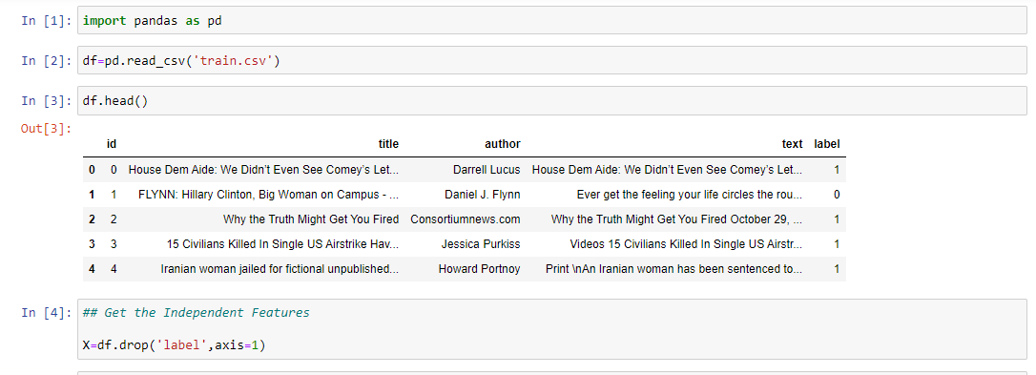
Importing the data set and getting independent features by dropping ‘Label’

Slide 14
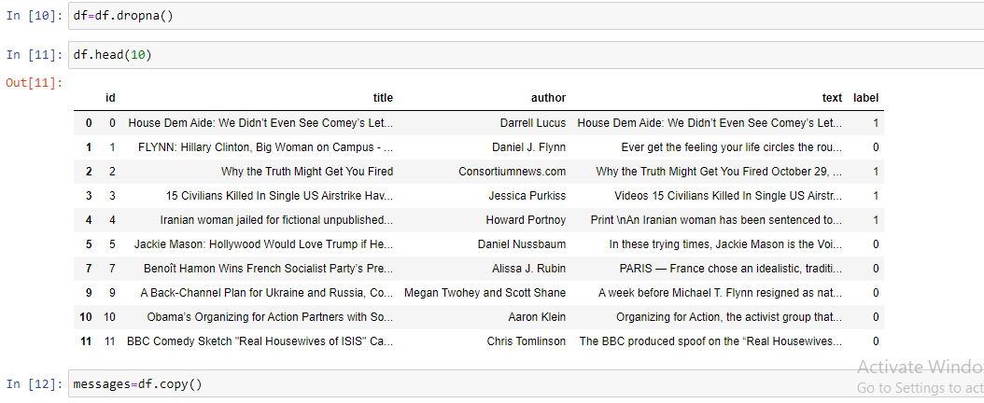
Dropping NAN values from dataset and transferring data into “message”

Slide 15
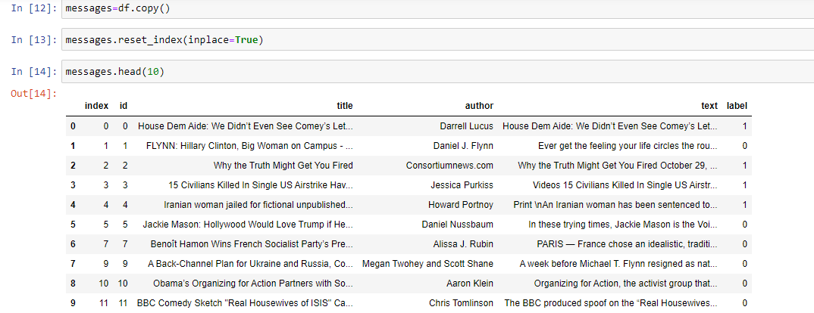
Resetting index after dropping NAN values

Slide 16
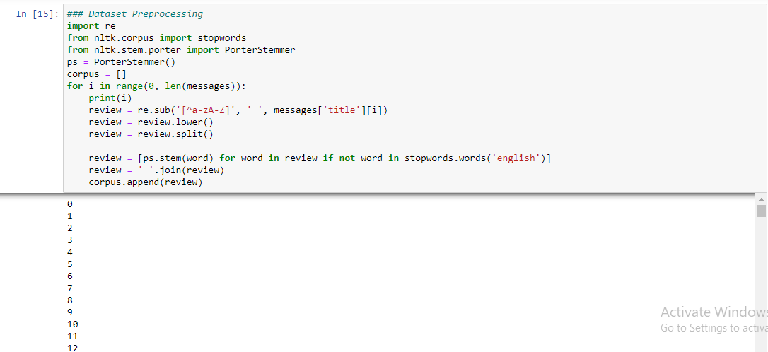
Data Preprocessing

Slide 17
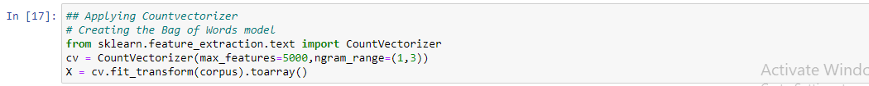

Applying countervectorizer in prototype 1 and applying TF-IDF in prototype 2

Slide 18

Dividing dataset into train and test

Slide 19
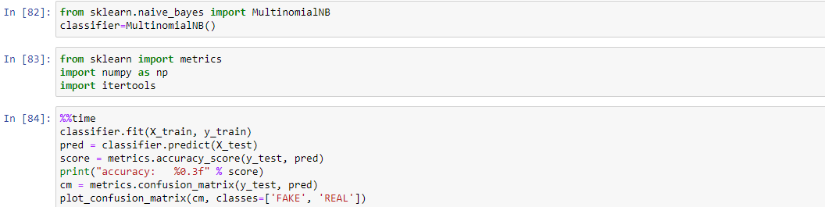
The multinomial naïve bayes classifier

Slide 20
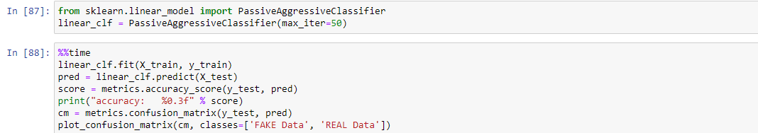
Passive Aggressive Classifier

Slide 21
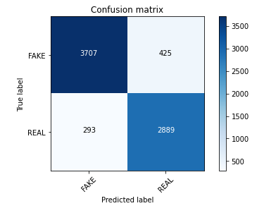
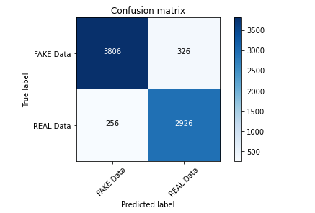
Confusion matrix of both classifiers in counter vecotrization
Naïve bayes
PAC

Slide 22
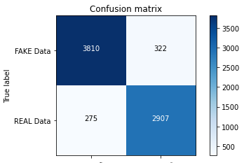
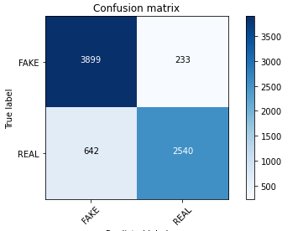
Confusion matrix of both classifiers in TF-IDF vecotrization
Naïve bayes
PAC

Slide 23
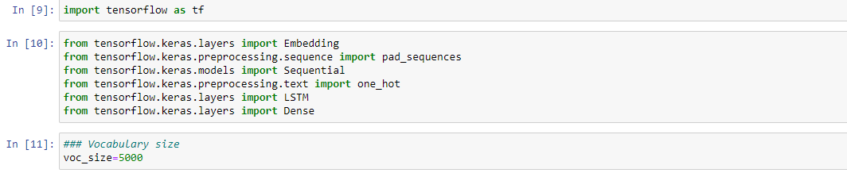
Importing libraries for LSTM

Slide 24
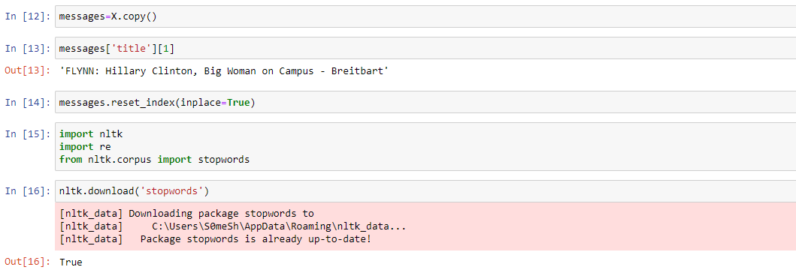
The one hot representation and data prepocessing

Slide 25
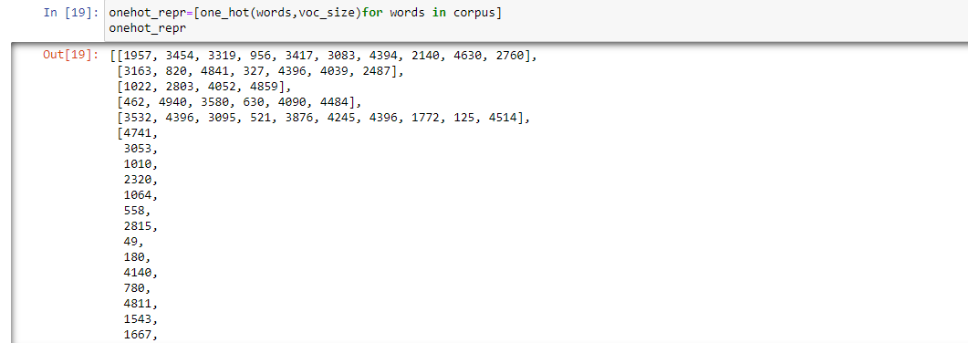

Slide 26
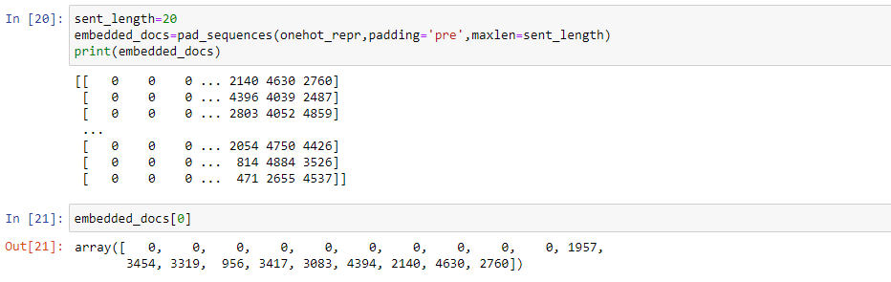
Embedding representation

Slide 27
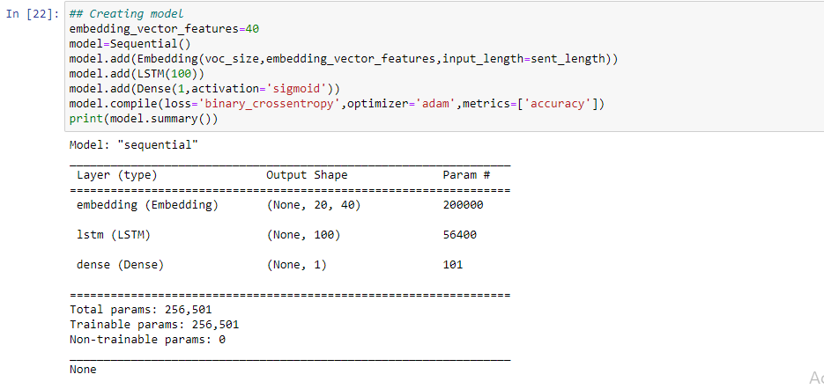
Model creation

Slide 28
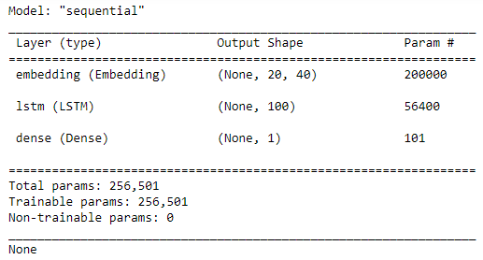
Sequential model

Slide 29
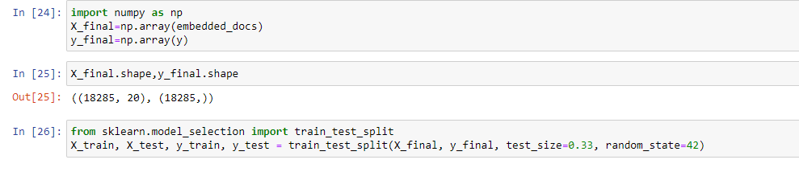
Split dataset into train and test

Slide 30
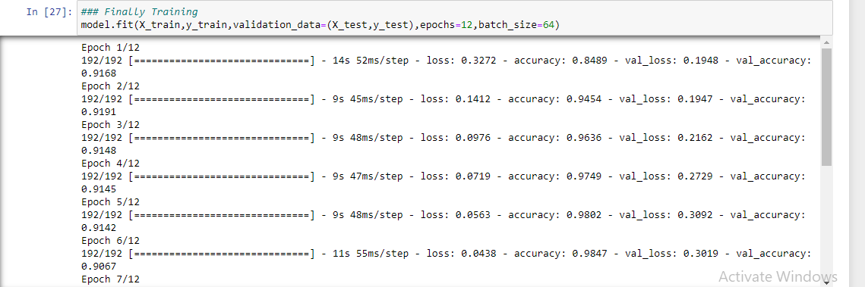
Model training

Slide 31
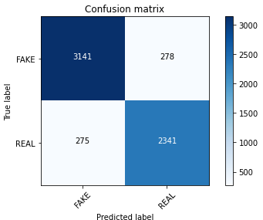
Confusion matrix of LSTM classifier

Slide 32
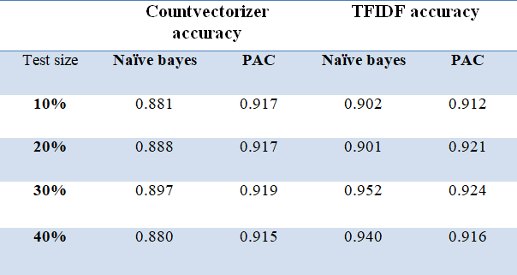
Accuracy table of both classifiers at different test data size and vectorization

Slide 33
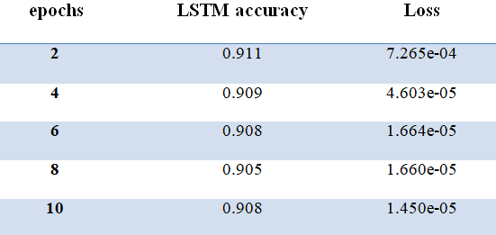
LSTM accuracy table

Slide 34
Conclusion
By comparing the three prototypes, it becomes clear that the refined prototype is more applicable to real world scenarios and larger data sets. According to a study from the University of Michigan, humans can only detect news at a 70 percent success rate. The models we have created easily surpass that by reaching accuracy rates of over 90 percent. While our prototypes have very high accuracy rates, there are also major flaw within them. For instance, they do not fact check, so that means that blatantly incorrect articles can be classified as real if they are written convincingly enough.
It also cannot detect click bait. These programs and models that were created shouldn’t be used by itself, but instead in a combination with human checkers. What these prototypes can do is that it can help filter out fake news and the news that is classified as real can be evaluated for validity by humans. Also, the people that are making”fake” news are always changing their styles, so the data for training the classifier always has to be updated.

Slide 35
Here in this paper we compared various methods like Bag Of Words(BoW), TF‐IDF, Naïve Bayes etc. LSTM to be most effective of all we used various techniques like stop word removal, one hot representation, word embedding. Model mentioned in this paper is very effective, also compared to existing system the model proposed here gives better results with accuracy of 91.05% which is very promising; we can further increase results by increasing training data.

